Slide 1
DATA PROCESSING AND DATA MANIPULATION
Dr. Sanda Thein
Professor
Dept of Statistics
Yangon University of Economics

Slide 2
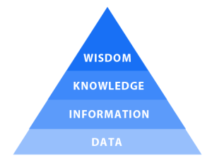
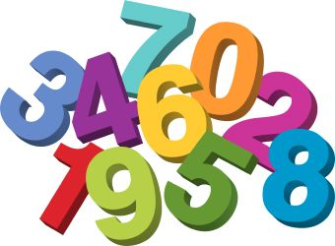

Data and Information
Data is set of qualitative or quantitative values. Data can be a number, symbol, character, word, codes, graphs, etc.
Information is the results of processing. Information is processed, organised and structured data. It provides context for data and enables decision making.
Dr. Soe Win ,Permanent Secretary (Ministry of Education)

Slide 3
Data Information Knowledge Wisdom (DIKW)
DIKW is the model used for discussion of data, information, knowledge, wisdom and their interrelationships.
It represents structural or functional relationships between data, information, knowledge, and wisdom.

Slide 4
KEY DIFFERENCE
Data is a raw and unorganized fact that is required to be processed to make it meaningful whereas Information is a set of data that is processed in a meaningful way according to the given requirement.
Data does not have any specific purpose whereas Information carries a meaning that has been assigned by interpreting data.
Data alone has no significance while Information is significant by itself.

Slide 5
KEY DIFFERENCE
6. Data never depends on Information while Information is dependent on Data.
7. Data measured in bits and bytes, on the other hand, Information is measured in meaningful units like time, quantity, etc.
8. Data can be structured, tabular data, graph, data tree whereas Information is language, ideas, and thoughts based on the given data.

Slide 6
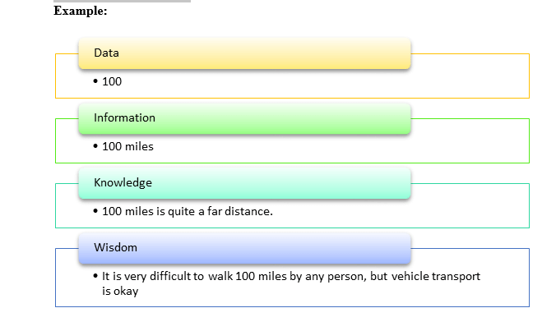

Slide 7




Sources of Data
Primary Sources
Secondary Sources
Primary sources are those in which we need to conduct a new survey for gathering information at different levels with regard to the inquiry.
Secondary sources are those which are made available or have been collected for other research purposes.
Dr. Soe Win ,Permanent Secretary (Ministry of Education)

Slide 8
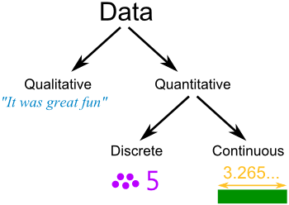
Types of Data
Qualitative data
Quantitative data
Qualitative data are numerically non measureable.
Quantitative data can be measure numerically.
Dr. Soe Win ,Permanent Secretary (Ministry of Education)

Slide 9
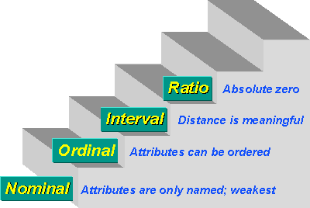
Measurement Levels of data
There are typically four levels of measurement that are defined:
Nominal
Ordinal
Interval (Scale in SPSS)
Ratio (Scale in SPSS)
3 Properties
Comparative
Additive
Multiplicative
Dr. Soe Win ,Permanent Secretary (Ministry of Education)

Slide 10
The Nature of Data
(1) Time Series Data
A set of observations that a variable takes at different times. They are usually collected at fixed intervals, such as daily, weekly, monthly, annually, quarterly, etc.
Example:
stock prices series, GDP series, yearly government budget, every ten years population
(2) Cross-Section Data
Data on one or more variables collected at the same point in time.
Examples: census data, survey data, opinion polls, temperature at a given time in several places.
Dr. Soe Win ,Permanent Secretary (Ministry of Education)

Slide 11
(3) Pooled data
It is a mixture of time series data and cross-section data. Example: GNP per capita of all European countries over ten years.
Panel, longitudinal or micropanel data
The data type is pooled data of nature. The difference is that we measure over the same cross-sectional unit for individuals.
(simply time series, cross-sectional, where the same cross-sectional units are not necessarily followed over time).
Dr. Soe Win ,Permanent Secretary (Ministry of Education)

Slide 12
Data Processing
Data processing occurs when data is collected and translated into usable information.
Collection
Preparation
Input
Processing
Output
Storage

Slide 13
six main steps in the data processing cycle:
Step 1: Collection
The collection of raw data is the first step of the data processing cycle.
The type of raw data collected has a huge impact on the output produced.
Raw data should be gathered from defined and accurate sources - the subsequent findings are valid and usable.
Raw data can include monetary figures, website cookies, profit/loss statements of a company, user behavior, etc.

Slide 14
Step 2: Preparation
Data preparation or data cleaning is the process of sorting and filtering the raw data to remove unnecessary and inaccurate data.
Raw data is checked for errors, duplication, miscalculations or missing data, and transformed into a suitable form for further analysis and processing. This is done to ensure that only the highest quality data is fed into the processing unit.
The purpose of this step to remove bad data (redundant, incomplete, or incorrect data)

Slide 15
Step 3: Input
the raw data is converted into machine readable form and fed into the processing unit. This can be in the form of data entry through a keyboard, scanner or any other input source.

Slide 16
Step 4: Processing
the raw data is subjected to various data processing methods using machine learning and artificial intelligence algorithms to generate a desirable output. This step may vary slightly from process to process depending on the source of data being processed (data lakes, online databases, connected devices, etc.) and the intended use of the output.

Slide 17
Step 5: Output
The data is finally transmitted and displayed to the user in a readable form like graphs, tables, vector files, audio, video, documents, etc. This output can be stored and further processed in the next data processing cycle.

Slide 18
Step 6: Storage
The last step of the data processing cycle is storage, where data and metadata are stored for further use. This allows for quick access and retrieval of information whenever needed, and also allows it to be used as input in the next data processing cycle directly.

Slide 19
What is data manipulation?
Data manipulation refers to the process of changing or transforming data in order to extract valuable insights, perform calculations, or prepare it for analysis and presentation. This can involve various operations such as filtering, sorting, aggregating, merging, and transforming data.

Slide 20

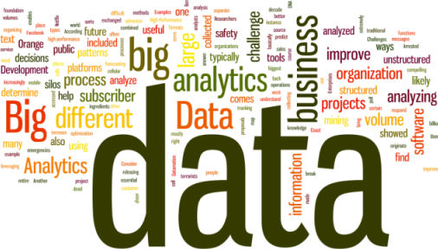


Data Manipulation
information
decisions
knowledge
Dr. Soe Win ,Permanent Secretary (Ministry of Education)

Slide 21
Why is data manipulation important?
Data manipulation is crucial in various fields, especially in technology, computing, programming, and communications. Through data manipulation, you can extract useful information from raw data, make it more structured, and perform necessary calculations and operations to derive meaningful insights.

Slide 22
What is the role of data manipulation in data analysis?
Data manipulation plays a crucial role in data analysis. Before performing any analysis, it is essential to manipulate the data to ensure its quality, relevance, and suitability for analysis.
Data manipulation allows analysts to clean and preprocess data, perform necessary transformations, and derive insights that can drive decision-making and inform strategic actions.

Slide 23
How does data manipulation contribute to data visualization?
Data manipulation is often a vital step in preparing data for visualization.
By manipulating data, you can structure it in a way that is conducive to visualization techniques such as charts, graphs.
Data manipulation helps in organizing, aggregating, and transforming data to highlight patterns, trends, and relationships, making it easier to create meaningful visualizations.

Slide 24
Data Manipulation Help in Identifying Outliers
Data manipulation can certainly help in identifying outliers.
By analyzing the distribution of data, applying statistical techniques, and performing data manipulation operations like filtering or calculating z-scores, you can detect data points that deviate significantly from the norm.
Outliers can provide valuable insights into unusual occurrences, anomalies, or errors in the data.

Slide 25
What is the difference between data manipulation and data analysis?
Data manipulation involves transforming and reshaping data to prepare it for analysis, while data analysis focuses on exploring and interpreting data to extract insights and make conclusions.

